Slide 1
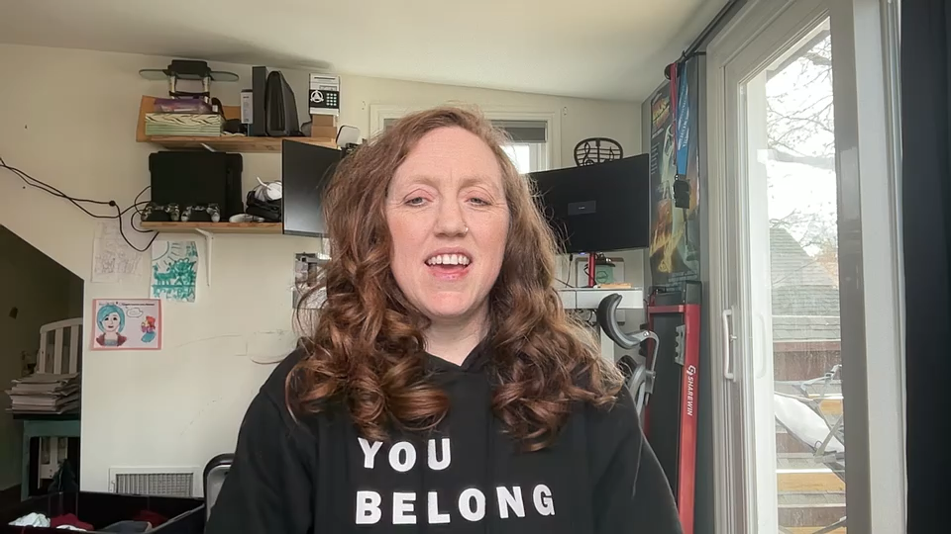
Football through the eyes of a Sports Fan turned Data Scientist
Bethel School of Technology –Capstone Presentation
By Krystal Darling

Slide 2
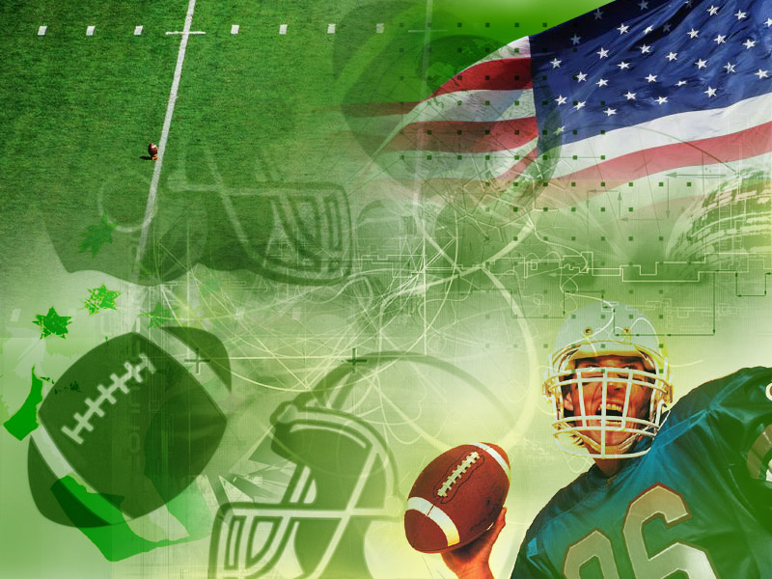

Name of presentation
About Me:
Wife & Mother of Six Children
Homemaker Extraordinaire
Bethel School of Technology Graduate –Data Science
B.A. in Arts, Media, and Culture
Customer service and manager for 18 years
Co-founder and Co-owner of Wild 6
Aspiring Data Analyst who loves research, statistics, and learning
Company name

Slide 3
Purpose/Table of Contents:
Introduction: Data and Programming Languages
Methods: Exploration and Analysis
What does the data say?
Analysis Questions
Summary
Machine Learning Models: Prediction, Accuracy, and Feature Importance
Conclusion
Q & A

Slide 4
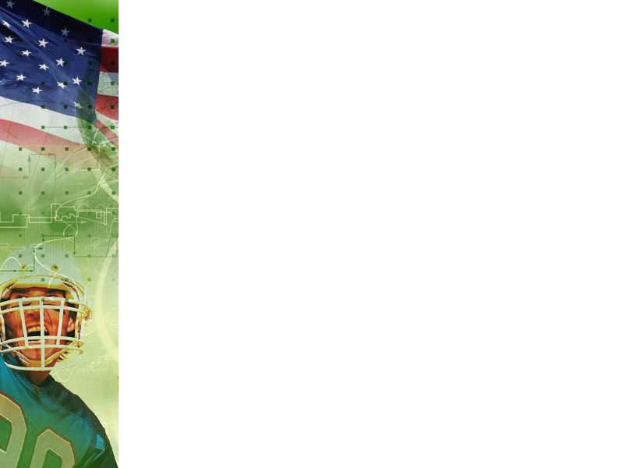



Project Introduction:
The Data:
2012 – 2022 NFL Defense and Offense Statistics
Pro Football Superbowl Data all Years
NFL.com Win/Loss Records by Year
Programming Languages and Visualization Tools:

Slide 5
The Methods:
Exploratory and Descriptive Analysis for each team and each variable
Distribution on all variables by team
Histograms
Scatterplots
Boxplots
Tree maps
Correlation
Bar charts
Machine Learning
Logistic Regression
Random Forests
Features Importance

Slide 6
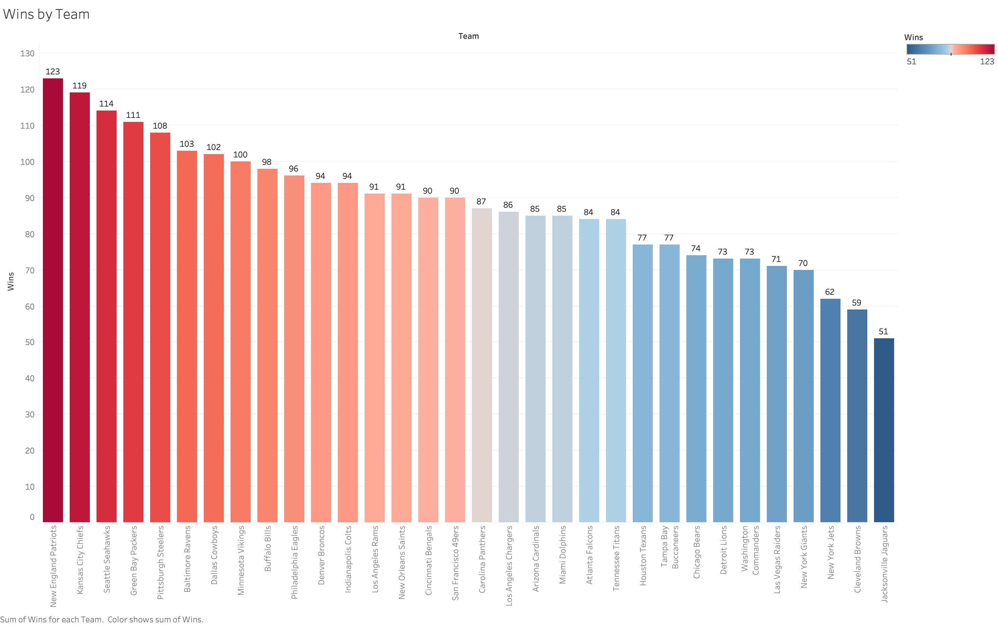
What does the data say?
Wins: Highest – Lowest - Trends

Slide 7
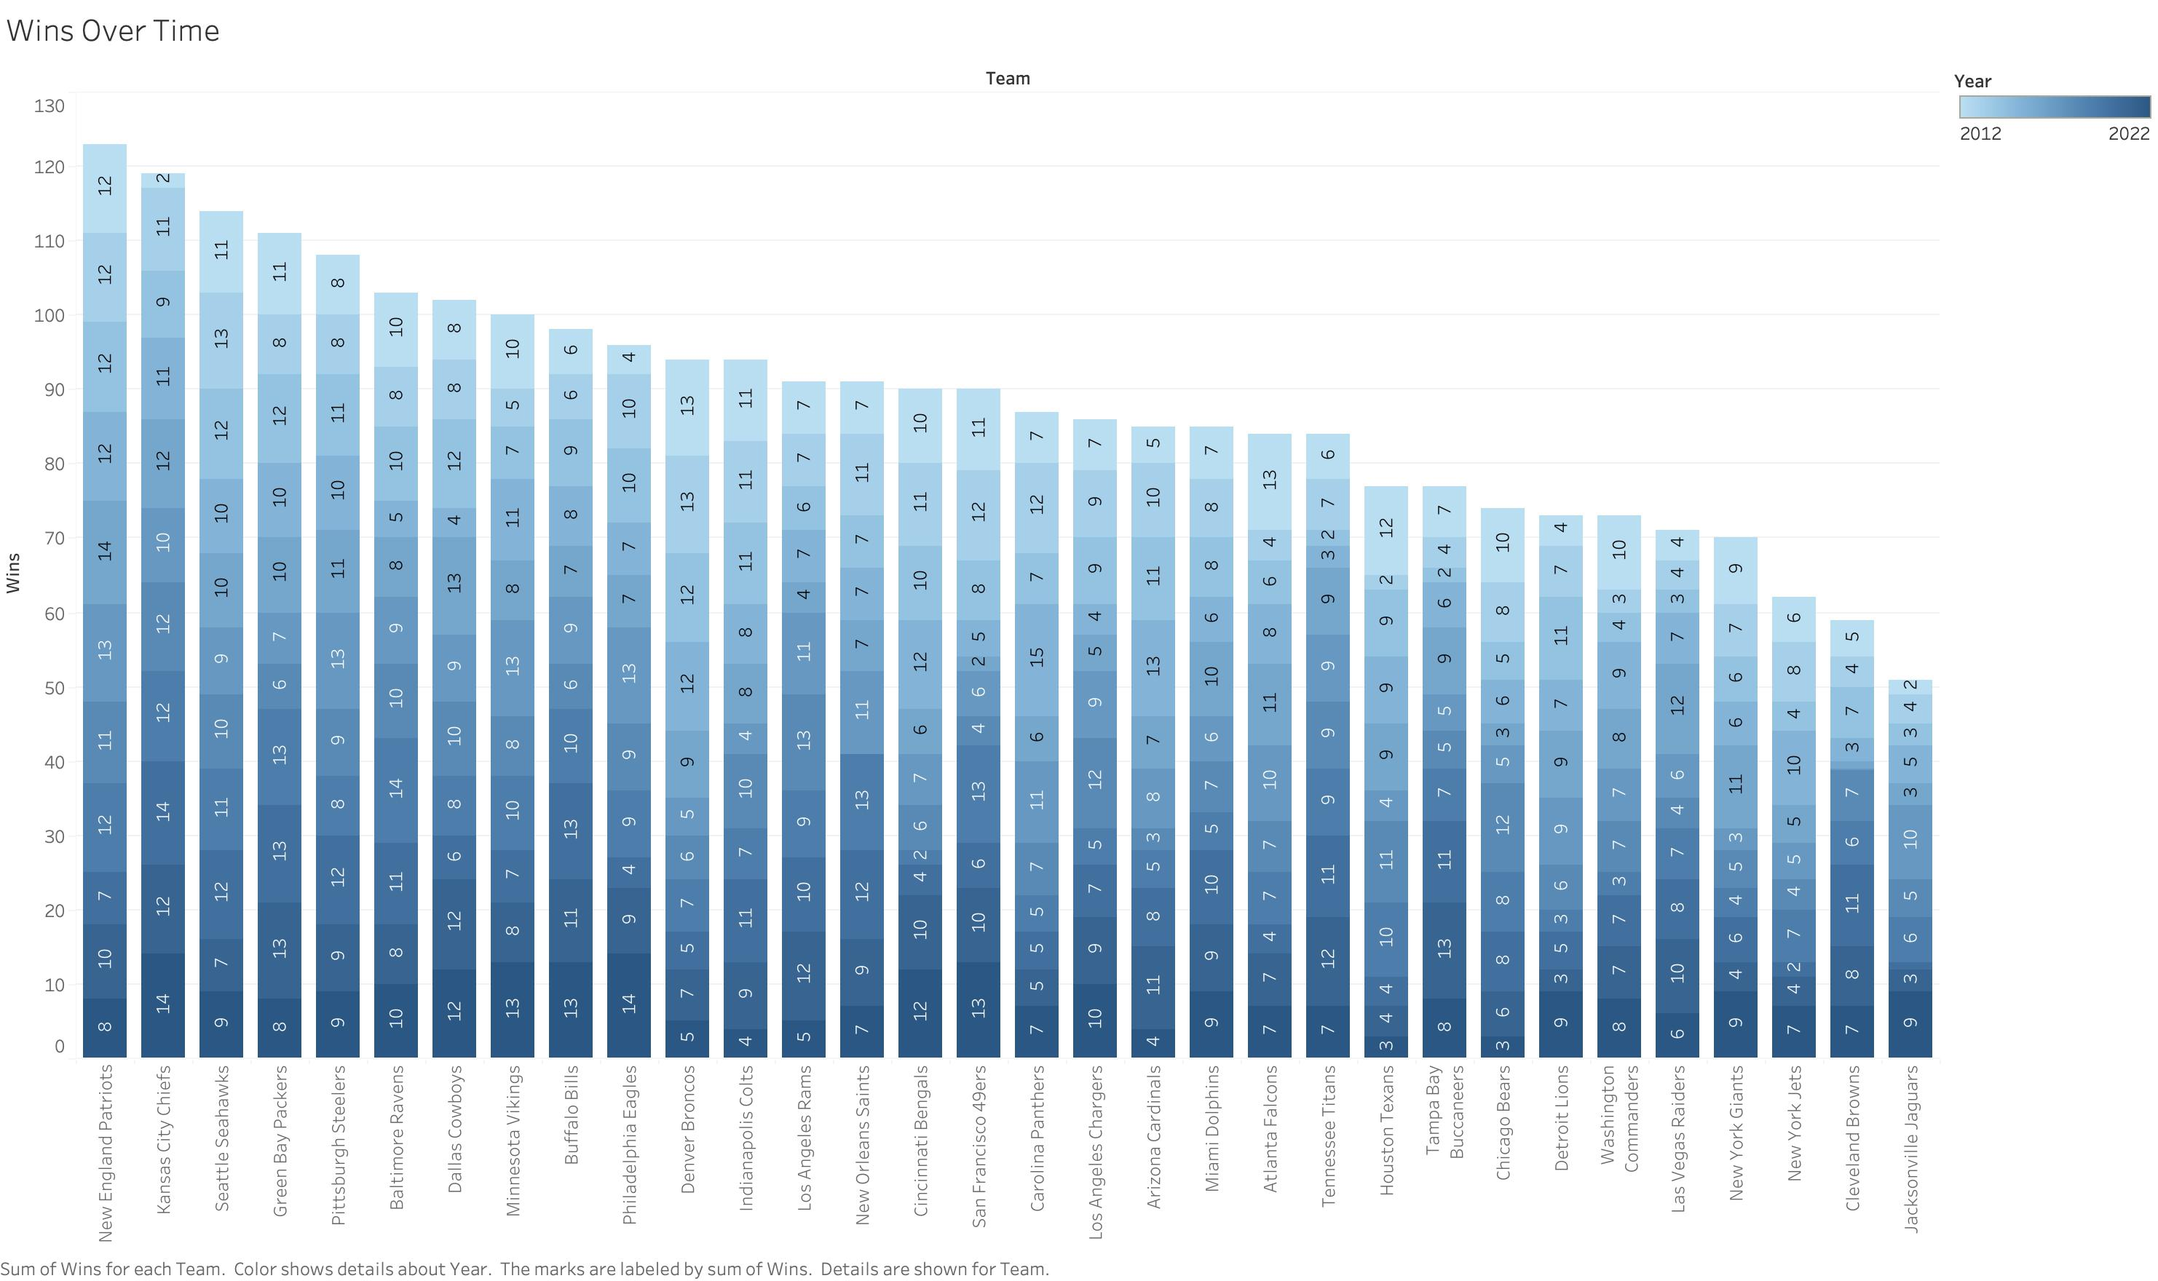
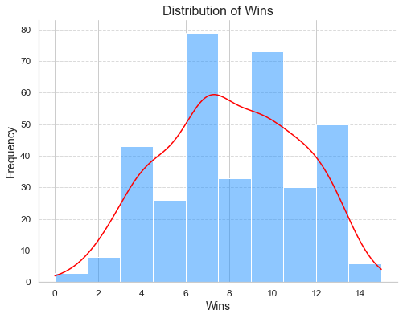

What does the data say?
Wins: Highest – Lowest - Trends
St. Dev: 3.09
Year with most Wins:
2021
271 Total Wins
Most Wins in a Season: 15 -2015

Slide 8











What does the data say?
Superbowl: Teams – Wins - Performance

Slide 9
What does the data say?
Superbowl: Teams – Wins - Performance
New England Patriots: 3 Superbowl wins, 4 Superbowl appearances
2014: 12 wins, 5848 Off Yards, 468 points, 29 pts/game
2016: 14 wins, 6180 Off Yards, 441 points, 27 pts/game
2017: 11 wins, 6307 Off Yards, 458 points, 28 pts/game 2018: 13 wins, 6298 Off Yards, 436 points, 27 pts/game
Tom Brady QB
Kansas City Chiefs: 2 Superbowl wins, 3 Superbowl appearances
2019: 12 wins, 6067 Off Yards, 451 points, 29 pts/game
2020: 14 wins, 6653 Off Yards, 473 points, 27 pts/game
2022: 14 wins, 7032 Off Yards, 496 points, 28 pts/game
Patrick Mahomes QB

Slide 10
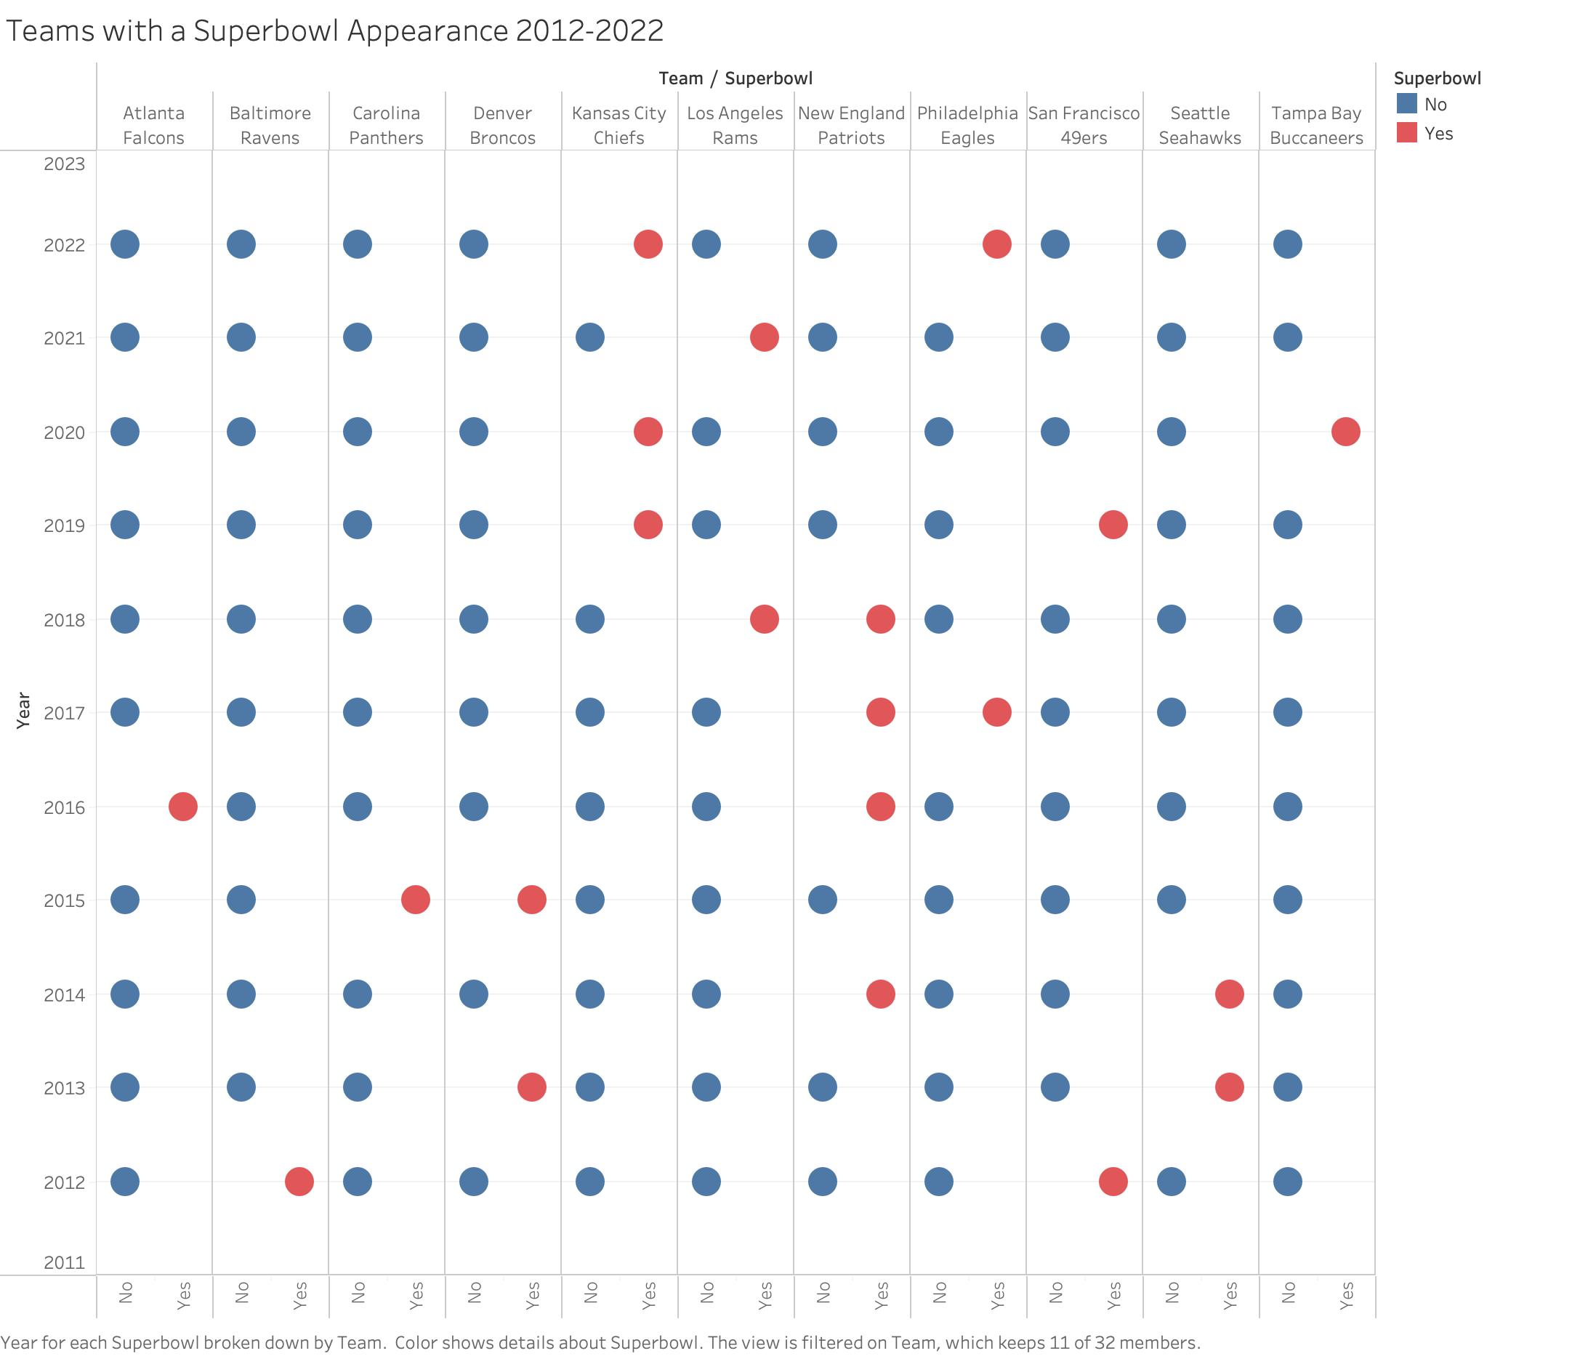
What does the data say?
Honorable Mentions:
Denver Broncos:
2 Superbowl appearances
1 win: 2015
Los Angeles Rams:
2 Superbowl appearances
1 win: 2021
Philadelphia Eagles:
2 Superbowl appearances
1 win: 2017
San Francisco 49ers:
2 Superbowl appearances
Seattle Seahawks:
2 Superbowl appearances
1 win: 2013
Tampa Bay Buccaneers:
1 Superbowl appearances
1 win: 2020
Tom Brady QB
Superbowl: Teams – Wins - Performance

Slide 11
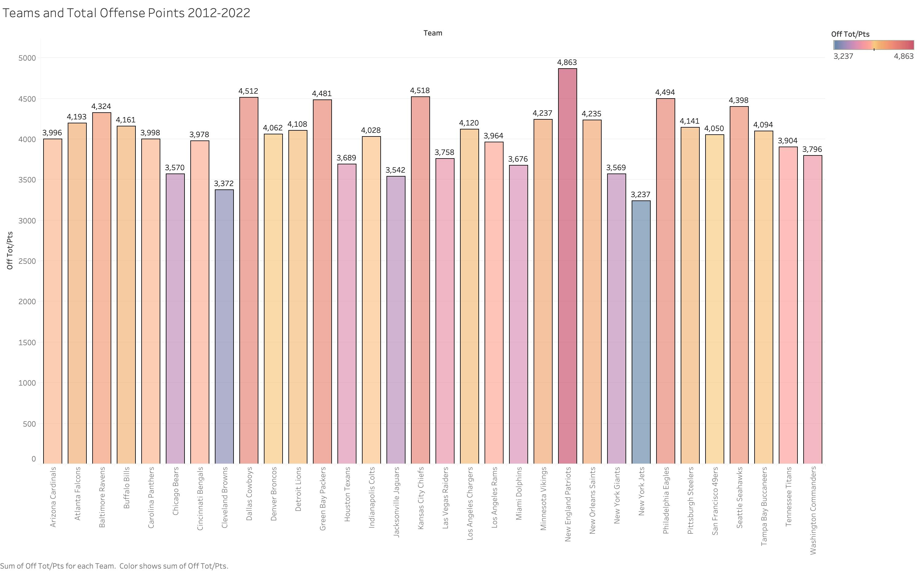
What does the data say?
Offense: Points – Passing – Rushing - Wins

Slide 12
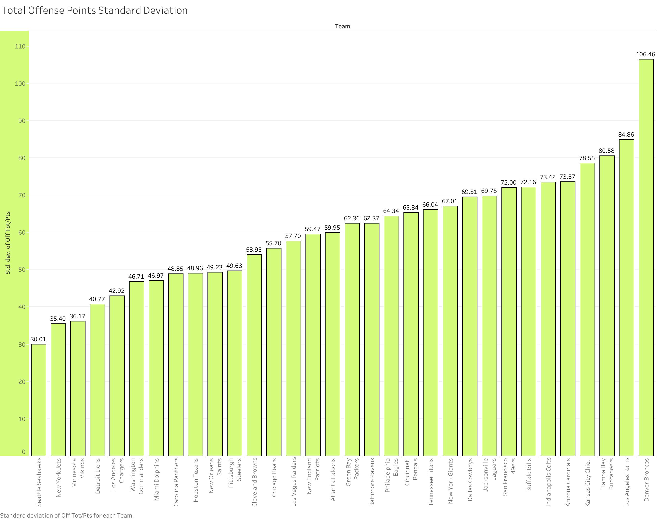
Name of presentation
What does the data say?
Offense: Points – Passing – Rushing - Wins
What does the data say?
Visualizations of descriptive statistics
Insights that led to analysis questions
Visualizations of descriptive statistics
Use graphs from tableau for variables over time, and variables for each team.
Company name

Slide 13
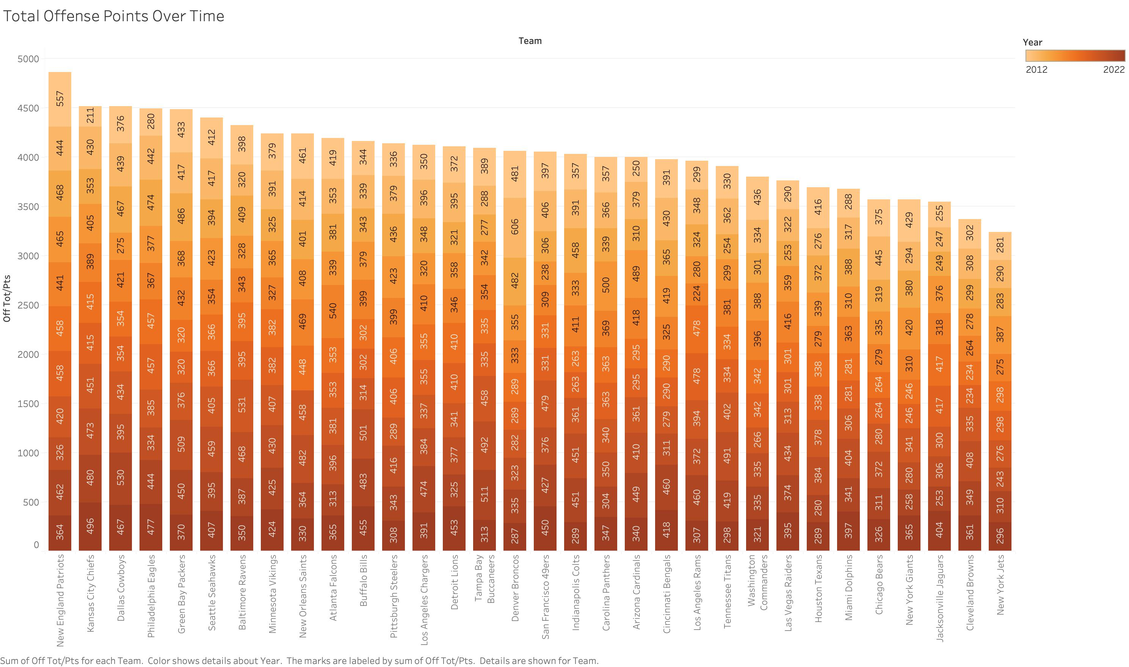
Name of presentation
What does the data say?
Offense: Points – Passing – Rushing - Wins
What does the data say?
Visualizations of descriptive statistics
Insights that led to analysis questions
Visualizations of descriptive statistics
Use graphs from tableau for variables over time, and variables for each team.
Company name

Slide 14
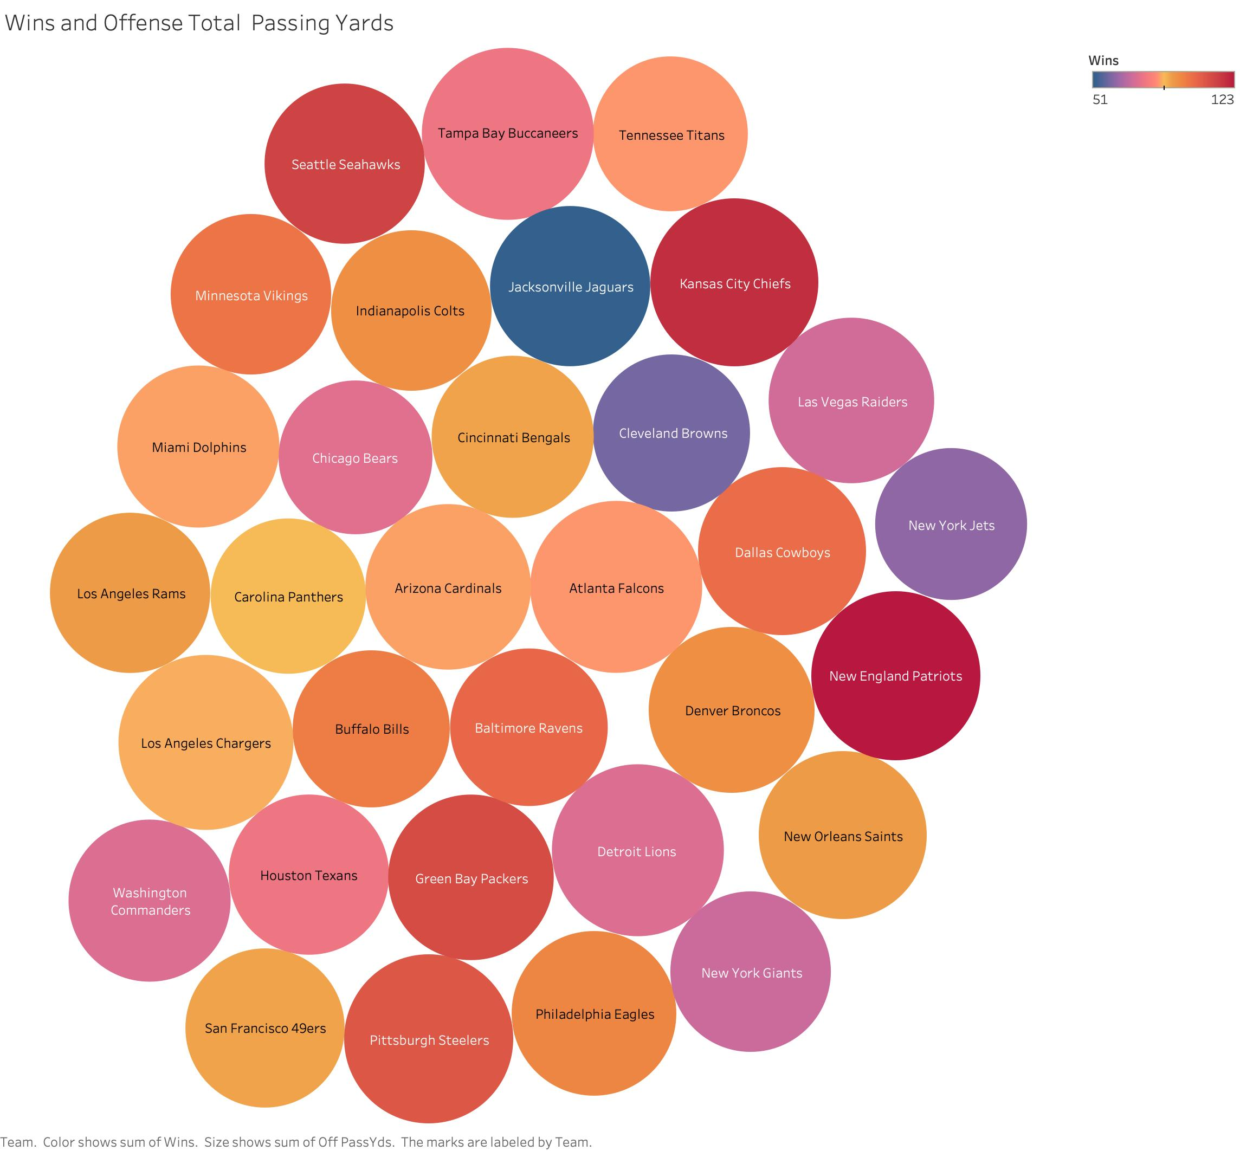
Name of presentation
What does the data say?
What does the data say?
Visualizations of descriptive statistics
Insights that led to analysis questions
Visualizations of descriptive statistics
Use graphs from tableau for variables over time, and variables for each team.
Offense: Points – Passing – Rushing - Wins
Company name

Slide 15
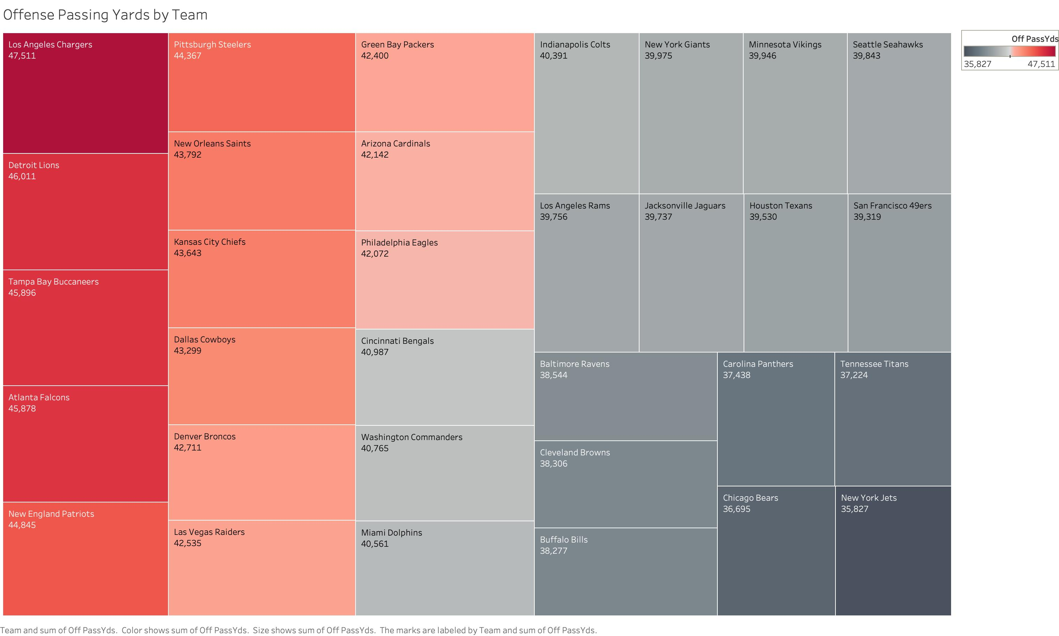
What does the data say?
Offense: Points – Passing – Rushing - Wins

Slide 16
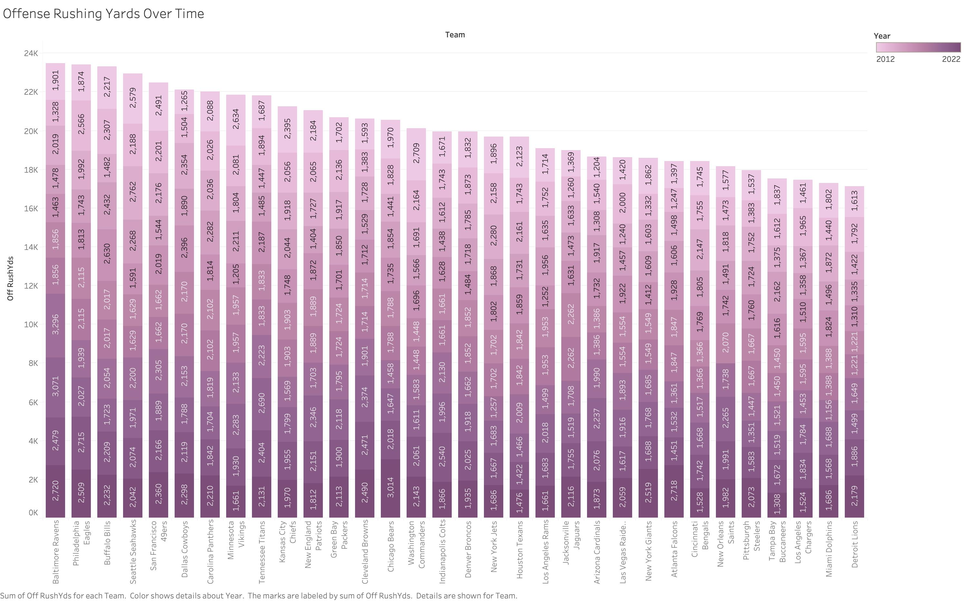
What does the data say?
Offense: Points – Passing – Rushing - Wins

Slide 17
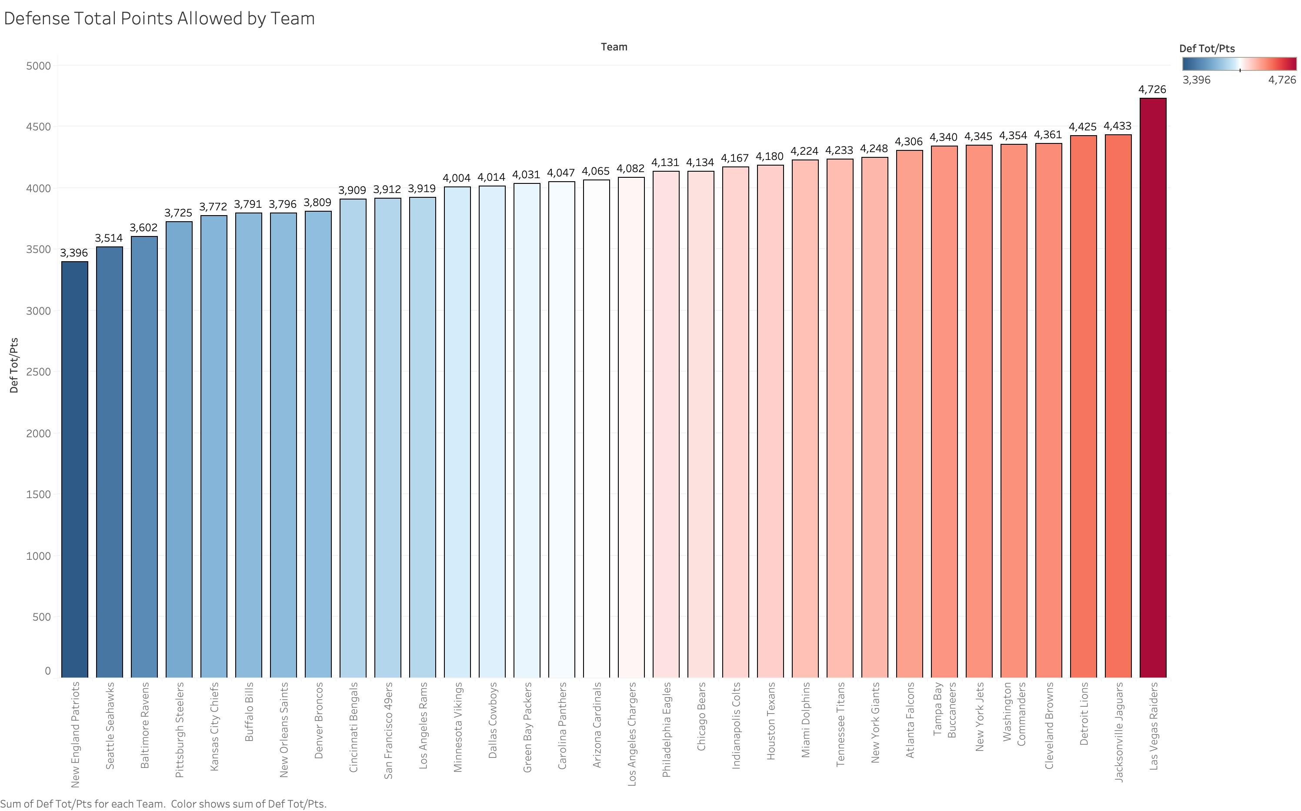
What does the data say?
Defense: Points Allowed – Passing Yards Allowed – Rushing Yards Allowed - Wins

Slide 18
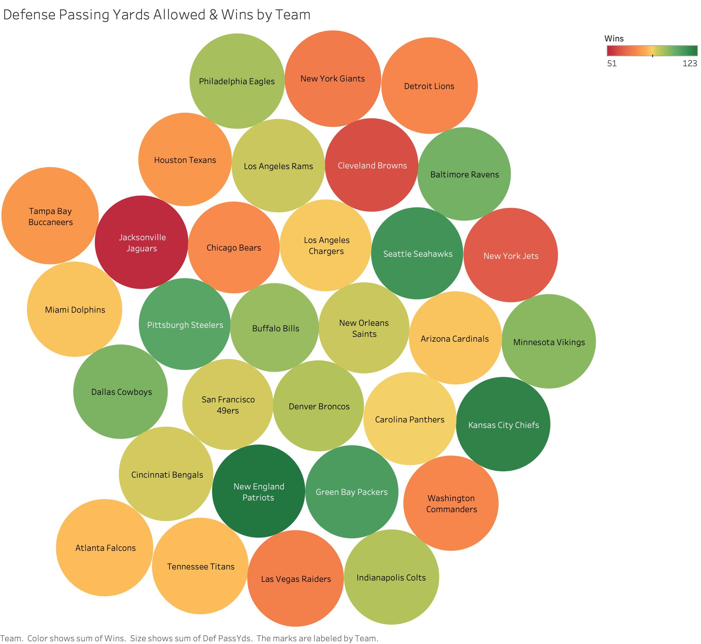
Name of presentation
What does the data say?
Defense: Points Allowed – Passing Yards Allowed – Rushing Yards Allowed - Wins
What does the data say?
Visualizations of descriptive statistics
Insights that led to analysis questions
Visualizations of descriptive statistics
Use graphs from tableau for variables over time, and variables for each team.
Company name

Slide 19
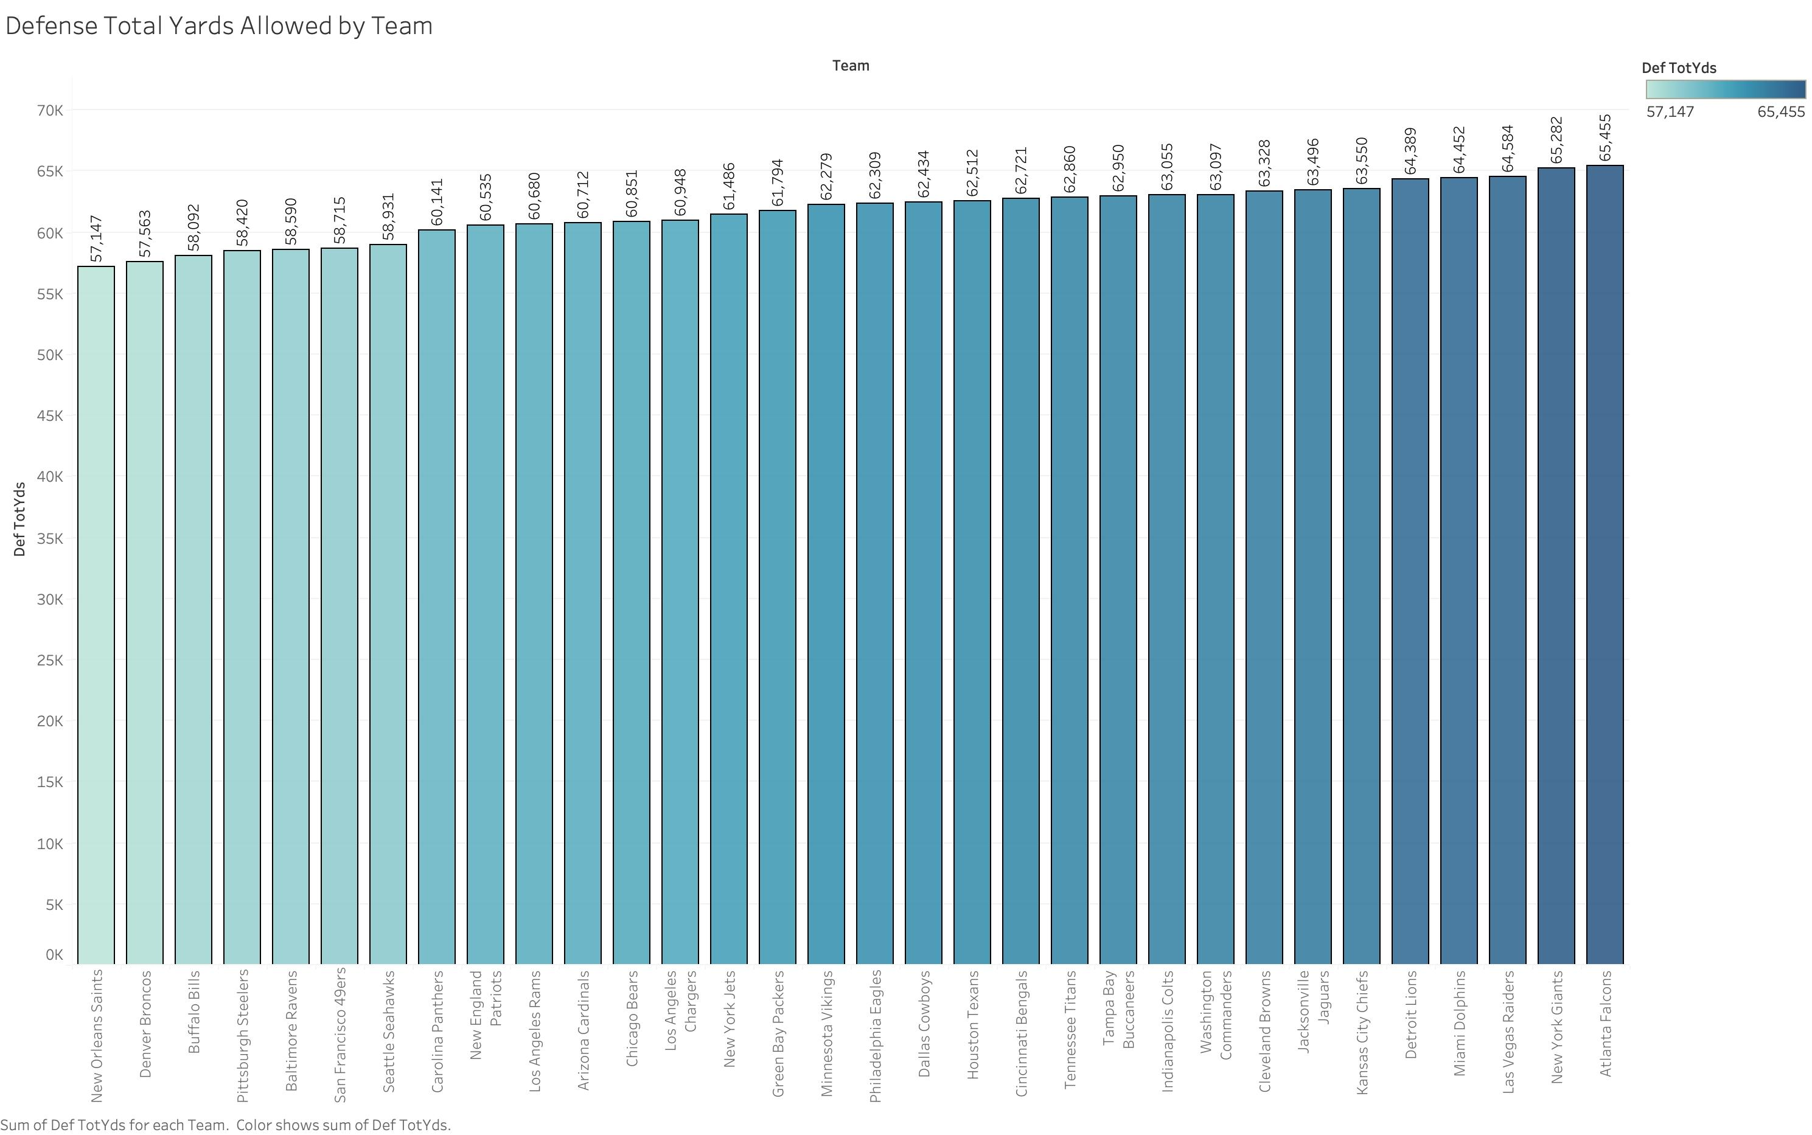
Name of presentation
What does the data say?
Defense: Points Allowed – Passing Yards Allowed – Rushing Yards Allowed - Wins
What does the data say?
Visualizations of descriptive statistics
Insights that led to analysis questions
Visualizations of descriptive statistics
Use graphs from tableau for variables over time, and variables for each team.
Company name

Slide 20
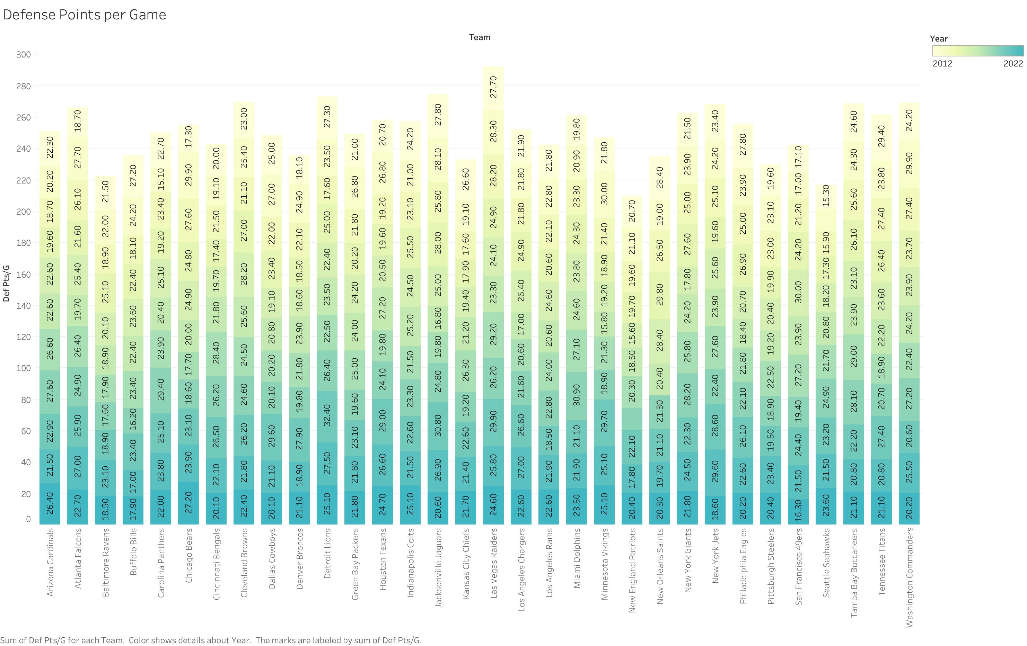
Name of presentation
What does the data say?
What does the data say?
Defense: Points Allowed – Passing Yards Allowed – Rushing Yards Allowed - Wins
Visualizations of descriptive statistics
Insights that led to analysis questions
Visualizations of descriptive statistics
Use graphs from tableau for variables over time, and variables for each team.
Company name

Slide 21
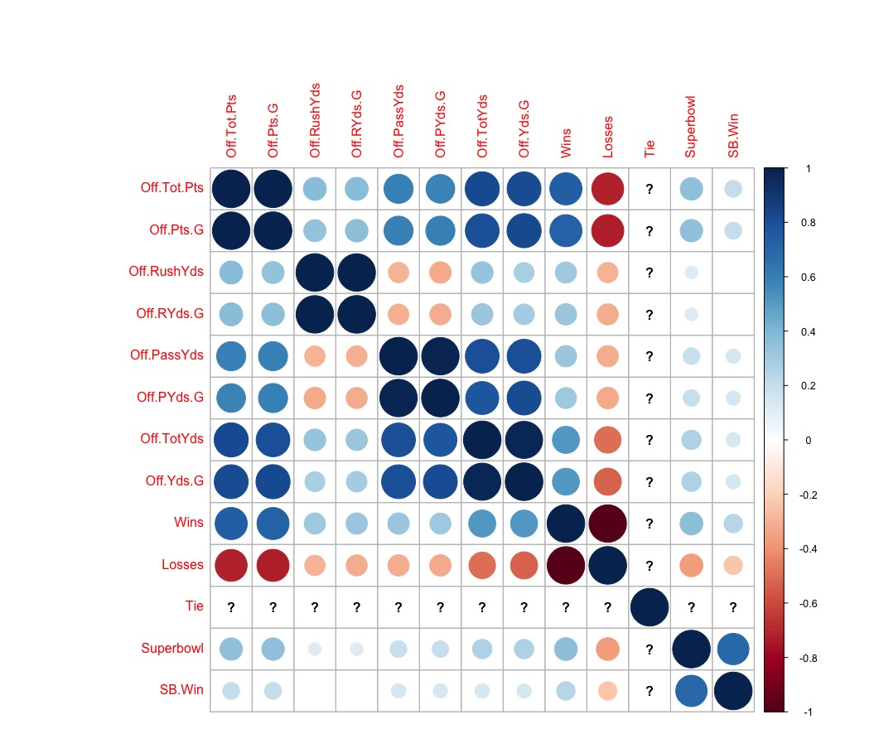
Correlation: Which variables impact wins the most? Superbowl appearances?
Offense Correlation:
Wins are + correlated to Total Offense Points & Offense Points per Game
Wins are not as correlated to SB Win as expected
Offense Passing Yards & Offense Rushing yards - as one goes up the other goes down
Offensive Passing Yards per game is negatively correlated to losses and positively to wins
Total Offense Points are positively correlated to total yards, yards per game, = more wins
Offensive Rushing Yards or Rushing Yards per Game seem to have no impact at all on a Superbowl Win
Points are more correlated to a Superbowl Win than Yards

Slide 22
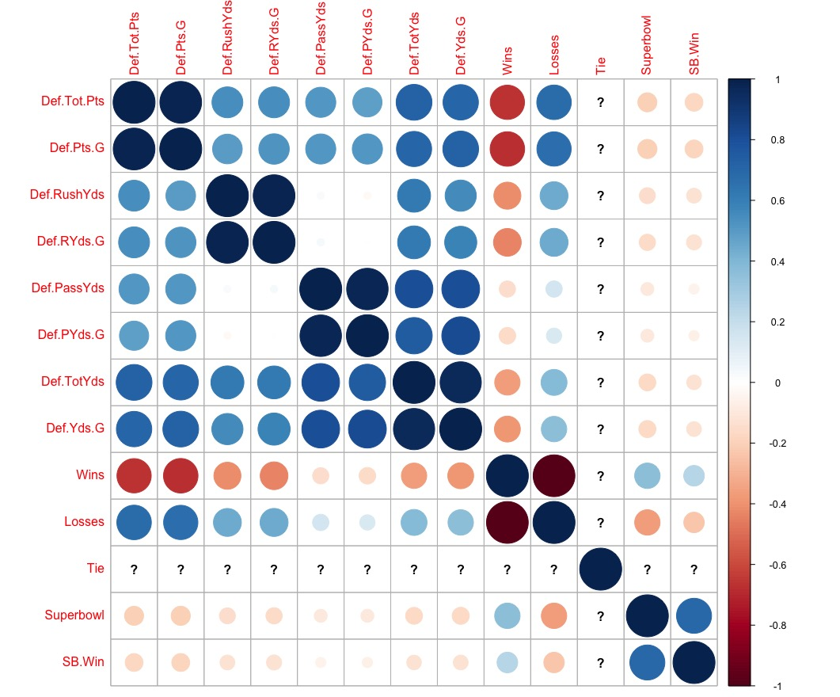
Correlation: Which variables impact wins the most? Superbowl appearances?
Defense Correlation:
High Points Allowed = Less Wins & More Losses
Defense Total Points are + correlated to more Yards allowed
Defense Rushing Yards Allowed correlates to a loss more than Defense Passing Yards Allowed
High Points Allowed = Less chance of Superbowl appearance or win
Defense Passing Yards and Rushing Yards are not correlated
Defense Passing Yards has almost no correlation to winning a Superbowl & little correlation to a Superbowl appearance

Slide 23
Analysis Questions:
Which team stands out on offense over time based on their total offensive yards, wins, and points?
Which team stands out on defense over time based on their total defensive yards and points?
Can I predict a Superbowl appearance based on offense and defense and historical data?

Slide 24
Analysis Question: Which team stands out on offense over time based on their total offensive yards, wins, and points?
4863 points
123 Wins
44,845 yards
Top Performing Offense: Wins, Total Points, and Total Offense Yards.
The New England Patriots outperformed all teams on offense in every category but Offense Rushing Yards from 2012-2022.

Slide 25

The Pittsburgh Steelers were the most consistent on defense throughout the years. They ranked in the top 5 teams in wins, total yards allowed, and points allowed. Rushing yards allowed they ranked 7th.
Analysis Question: Which team stands out on Defense over time based on their total yards allowed, wins, and points allowed?
3,825 points allowed
108 Wins
58420 yards allowed
Top Performing Defense: Wins, Least Points allowed, and Least Yards allowed
Notes:
consistecons

Slide 26
Summary:
The New England Patriots and the Kansas City chiefs have dominated the offense and Superbowl world for the last decade.
There are consistently 3 teams in the bottom rankings over all : New York Jets, Cleveland Browns, Jacksonville Jaguars.
Teams with better offense have been seen in the Superbowl from 2012-2022 more than defense heavy teams.
Defense Points and Yards allowed has a great impact on your win/loss record.
Only 11 of 32 Teams have been seen in a Superbowl in the last decade.

Slide 27
Name of presentation
Machine Learning Models: Prediction, Accuracy, and Feature Importance
What does the data say?
Visualizations of descriptive statistics
Insights that led to analysis questions
Visualizations of descriptive statistics
Use graphs from tableau for variables over time, and variables for each team.
Model Setup:
Can I predict a Superbowl appearance based on offense and defense and historical data?
Company name
Models:
Random Forest - Confusion Matrix - Classification Report - Logistic Regression

Slide 28
Machine Learning Models: Prediction, Accuracy, and Feature Importance
Random Forest Model 1:
Variables used:
Offense Total Points
Offense Passing Yards
Offense Rushing Yards
Wins
Losses
Defense Total Points
Defense Passing Yards
Defense Rushing Yards
Accuracy: 7 %
Did not seek actual team predictions

Slide 29
Machine Learning Models: Prediction, Accuracy, and Feature Importance
Random Forest Model 2:
Variables used:
Offense Total Points
Offense Passing Yards
Offense Rushing Yards
Wins
Losses
Offense Total Points/Game
Offense Passing Yards/Game
Offense Points/Game
Accuracy: 21%
This was my best prediction model.

Slide 30
Machine Learning Models: Prediction, Accuracy, and Feature Importance
Random Forest Model 3:
Variables used:
Offense Total Points
Offense Passing Yards
Offense Rushing Yards
Wins
Losses
Offense Total Points/Game
Offense Passing Yards/Game
Offense Points/Game
Year
Accuracy: 18 %

Slide 31


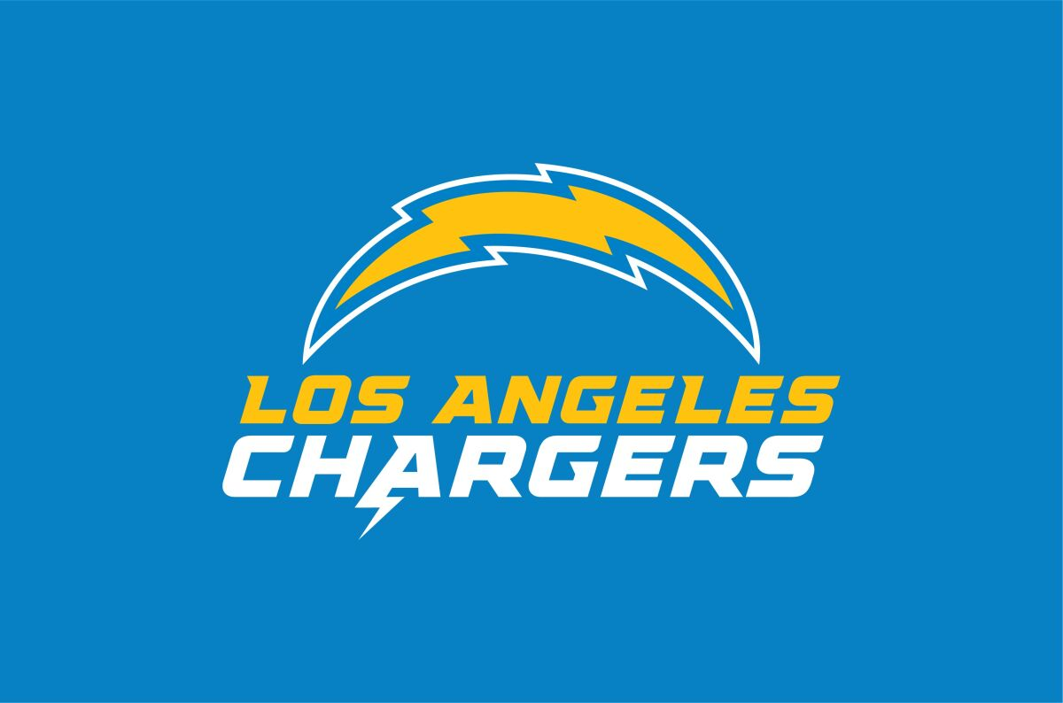
Machine Learning Models: Prediction, Accuracy, and Feature Importance
Random Forest Model 4:
All Offense and Defense variables used + Win/Loss Record +
Superbowl Appearance and Superbowl Wins
Accuracy: 7 %
Prediction Results:

Slide 32
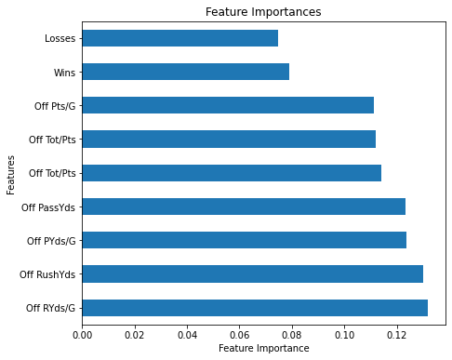
Machine Learning Models: Prediction, Accuracy, and Feature Importance

Slide 33


Machine Learning Models: Prediction, Accuracy, and Feature Importance
Logistic Regression Model 1:
Variables used:
Offense Total Points
Offense Passing Yards
Offense Rushing Yards
Wins
Losses
Offense Total Points/Game
Offense Passing Yards/Game
Offense Points/Game
Year
Accuracy: 4 %
Prediction Results:

Slide 34
Machine Learning Models: Prediction, Accuracy, and Feature Importance
Logistic Regression Model 2:
Variables used:
Offense Total Points
Offense Passing Yards
Offense Rushing Yards
Wins & Losses
Offense Total Points/Game
Offense Passing Yards/Game
Offense Points/Game
Accuracy: 5.6 %
Prediction Results:

Slide 35

Machine Learning Models: Prediction, Accuracy, and Feature Importance
Logistic Regression Model 3:
Just Offense Variables used
Accuracy: 4.2%
Prediction Results:

Slide 36
Machine Learning Models: Prediction, Accuracy, and Feature Importance
Logistic Regression Model :
Just Defense Variables + Superbowl Appearance and Superbowl Win used
Accuracy: 2.8%
Prediction Results:

Slide 37
Conclusion
My data is too simple for an accurate predictor.
This last decade has been a show of Offense Performance among teams.
Wins and losses are not the most important predictors of a Superbowl Winning Team.
Multiple variables are required for complete sports analysis!
2012-2022 showed that the old adage “Defense wins Championship” isn’t always the case.

Slide 38
Name of presentation
Questions and Comments
Company name

Slide 39
Sources and Citations:
The Data:
2012 – 2022 NFL Defense and Offense Statistics
https://www.kaggle.com/datasets/kristofanderson/2012-2022-nfl-defense-and-offensive-statistics
Pro Football Superbowl Data all Years
https://www.pro-football-reference.com/super-bowl/
NFL.com - Win/Loss Records by Year
https://www.nfl.com/standings/league/2022/REG
Other Sources:
PowerPoint Template Photos
https://poweredtemplate.com/00505/0/index.html
ChatGPT:
https://chat.openai.com
Team Logos

Slide 40
Thank You!!

